Slide 1
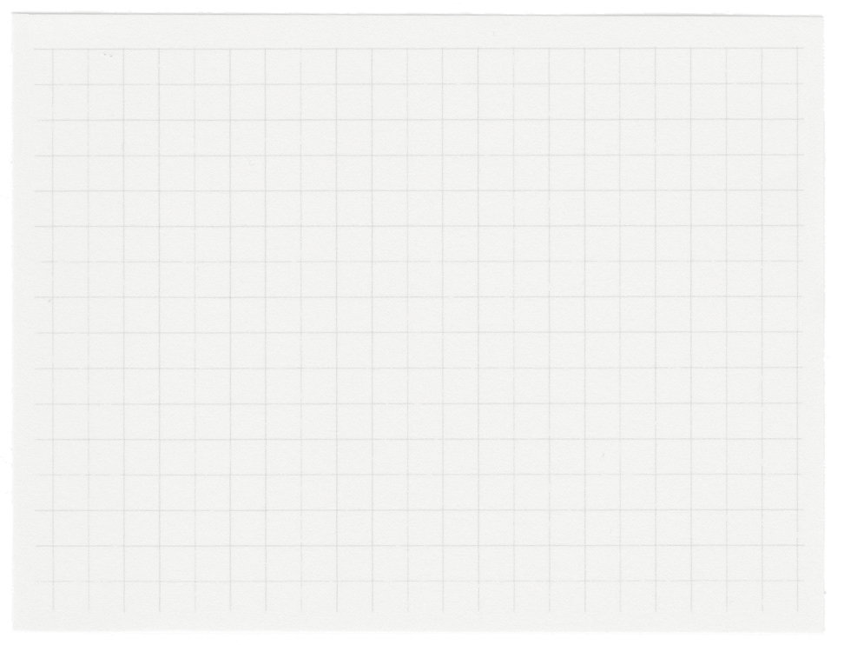
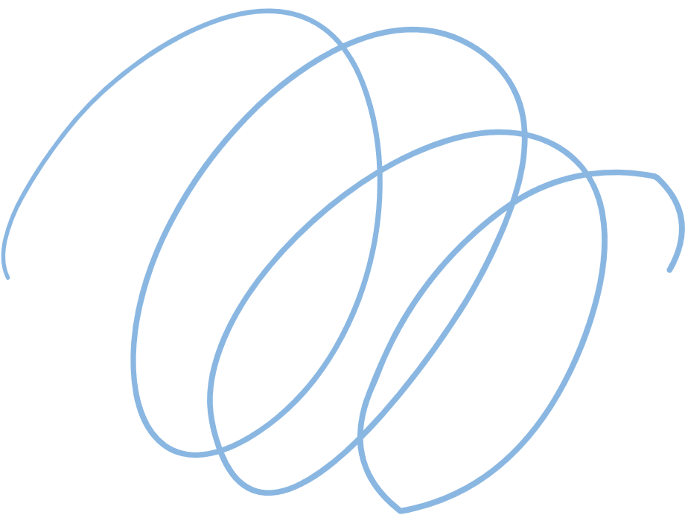


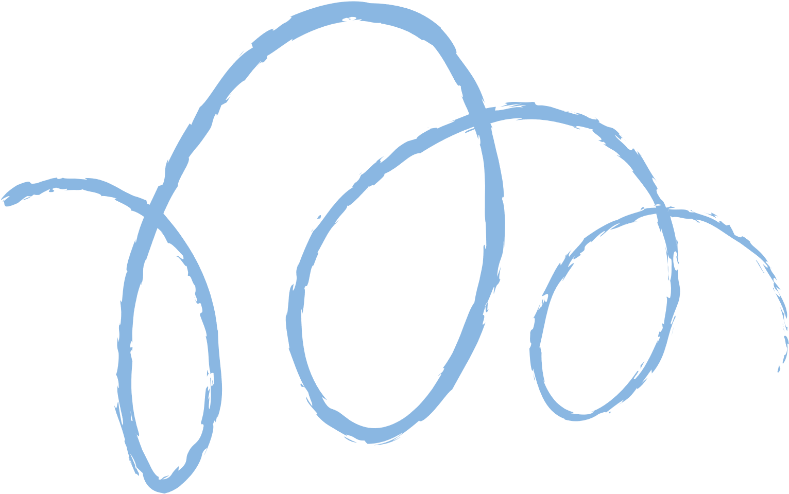









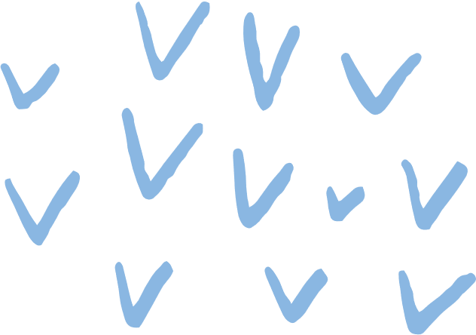
Regression Evaluation & Lasso, Ridge models
Presented by
FCAI-CU-AI-Community

Slide 2
In Previous Session.

Slide 3
Linear Regression simply is just finding
best line to fit our data

Slide 4
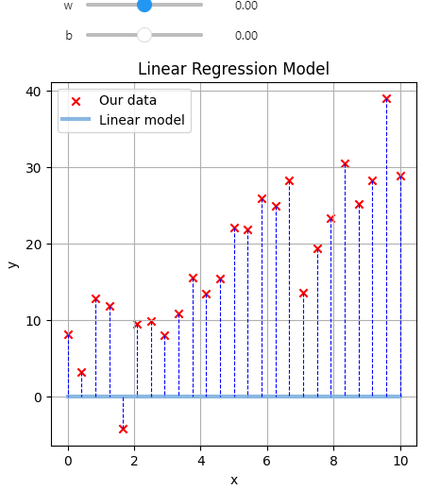
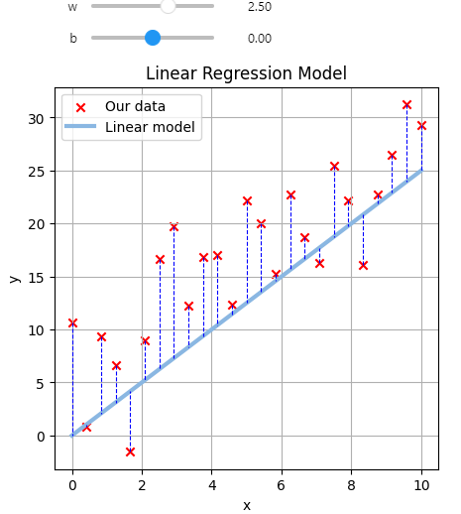
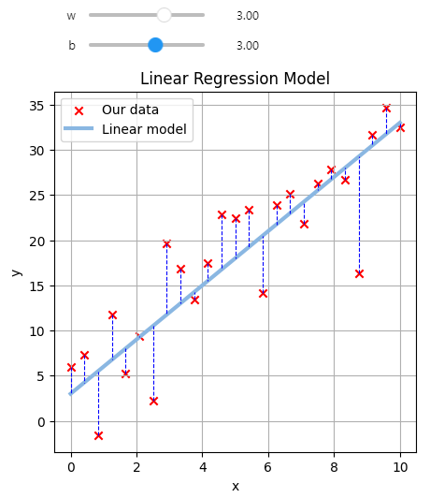
Is measuring distance between actual and predict
can help us?
W = 0, b = 0
W = 2.5, b = 0
W = 3, b = 3

Slide 5
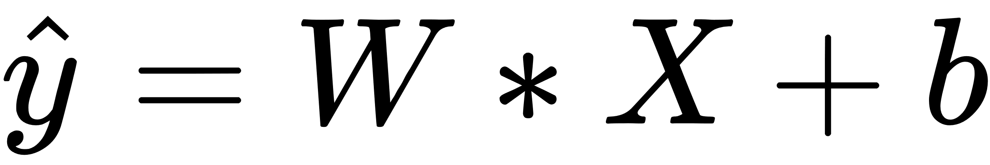

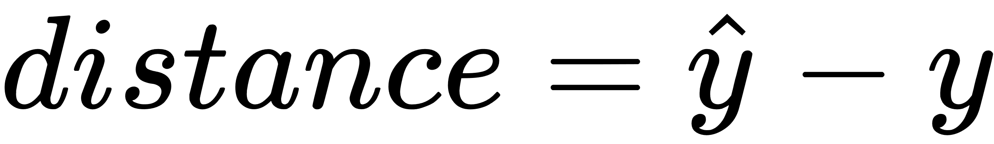
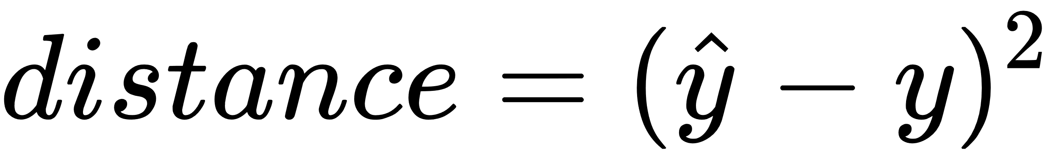
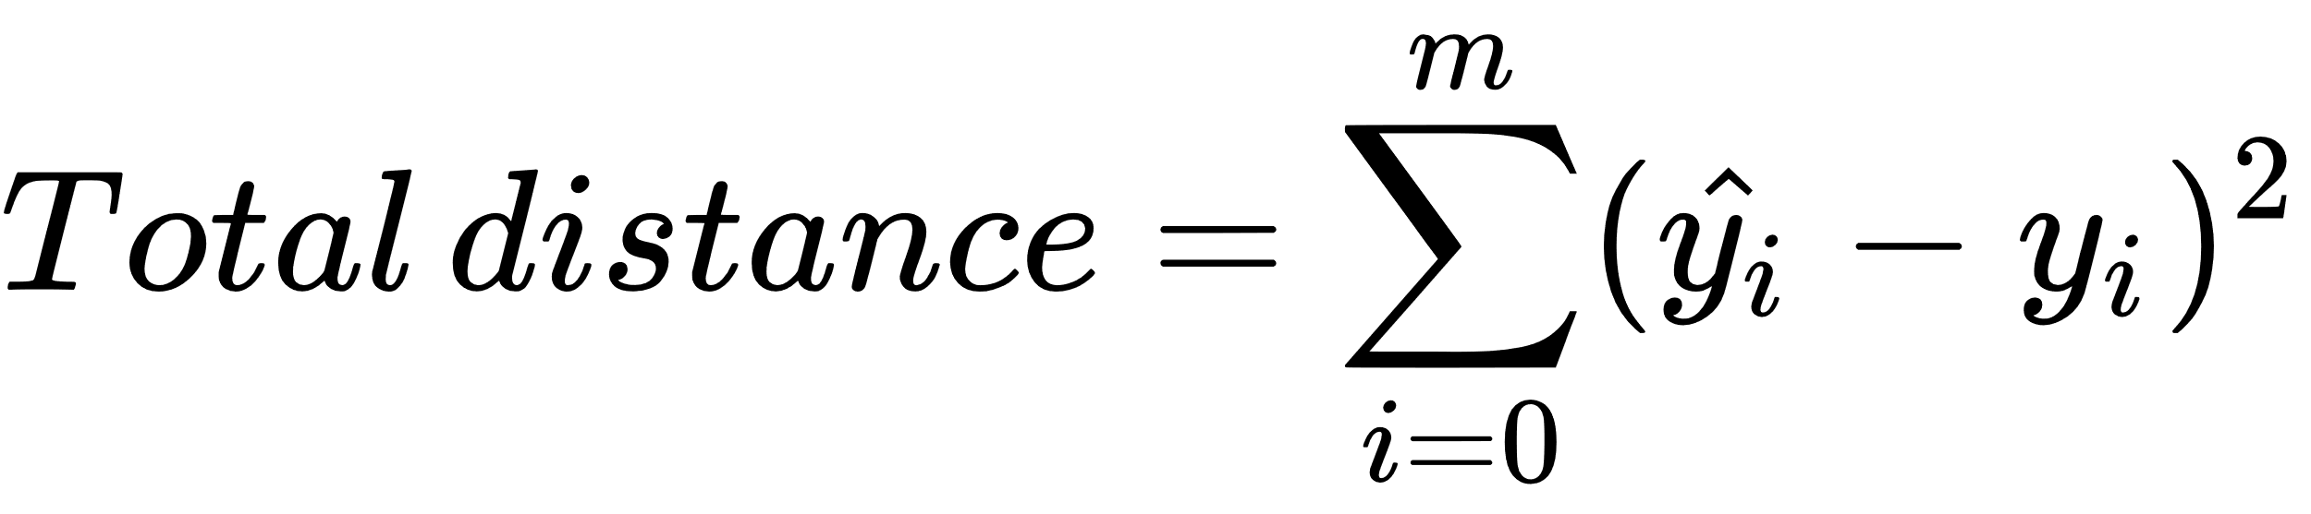
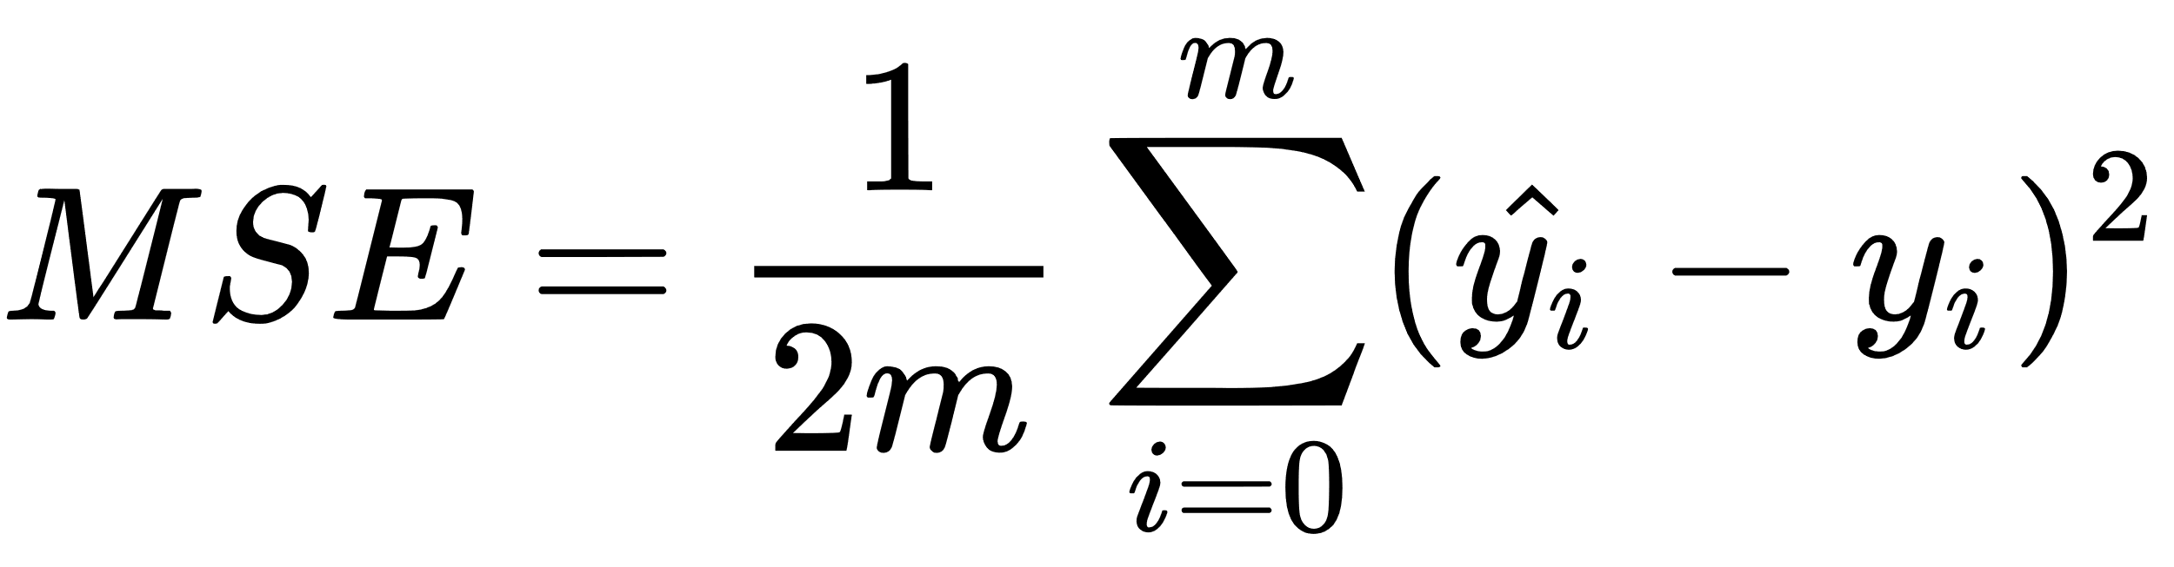

Slide 6
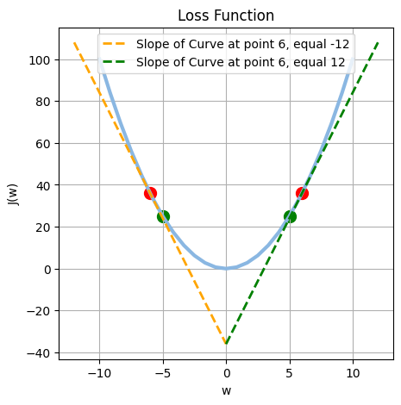
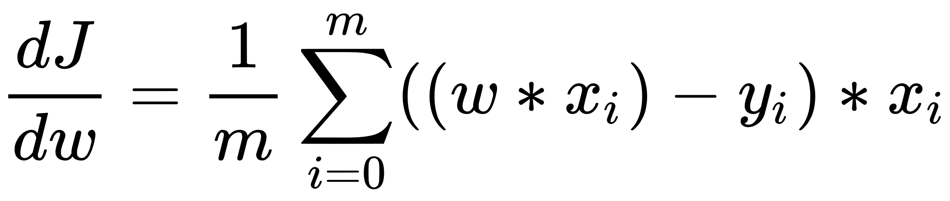
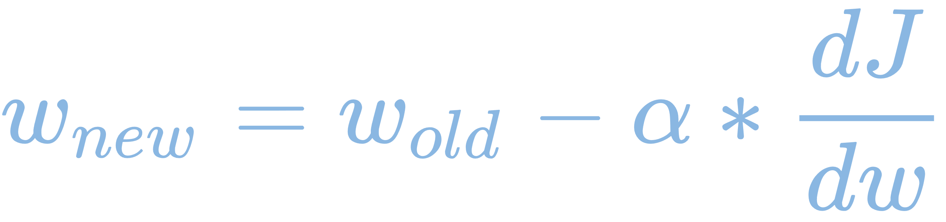

Slide 7
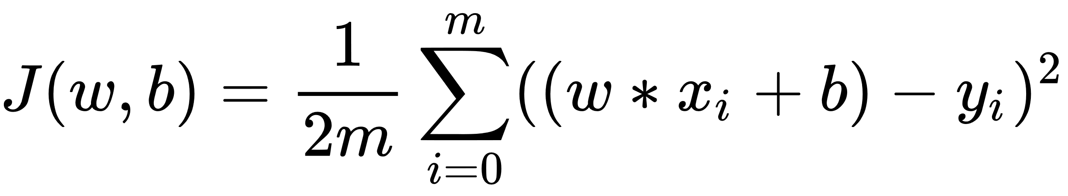
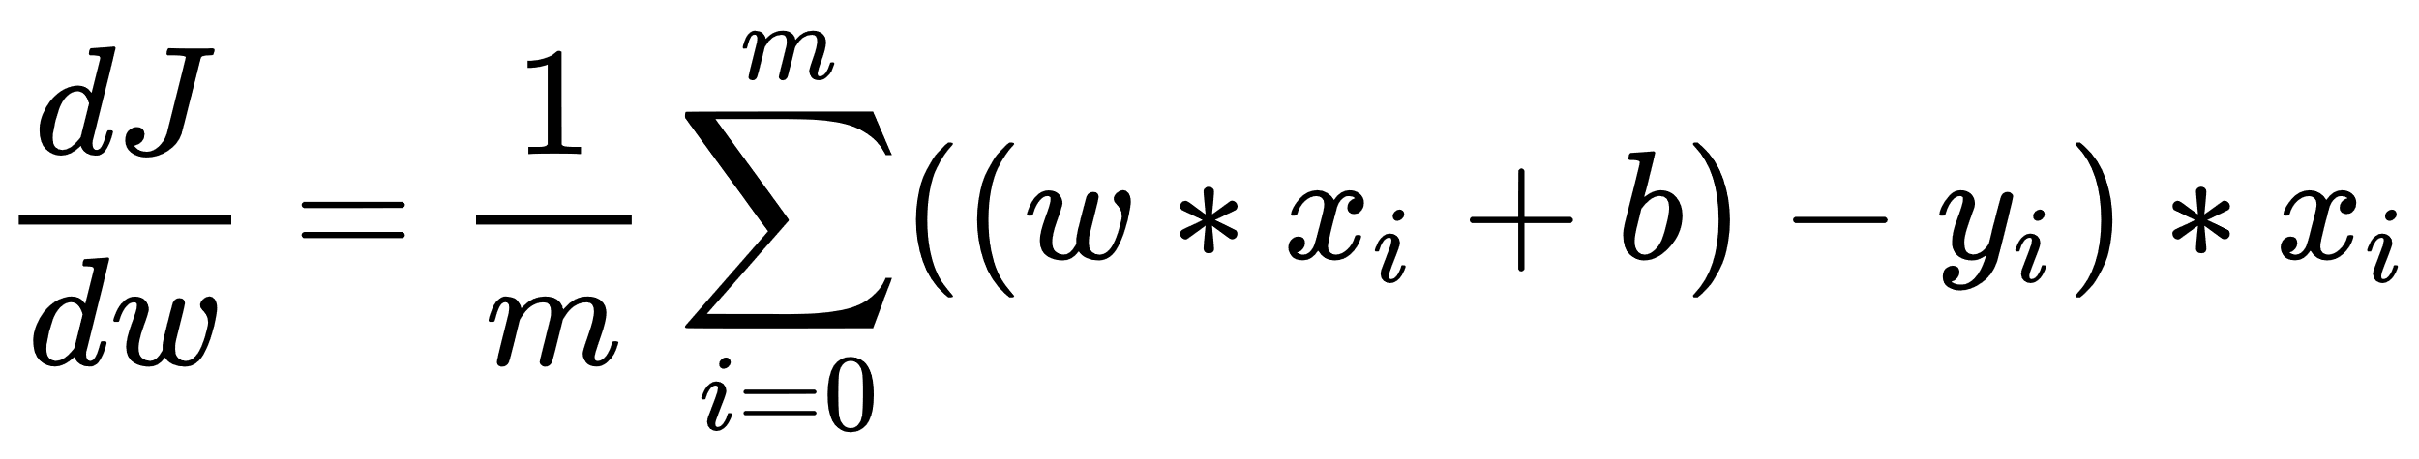
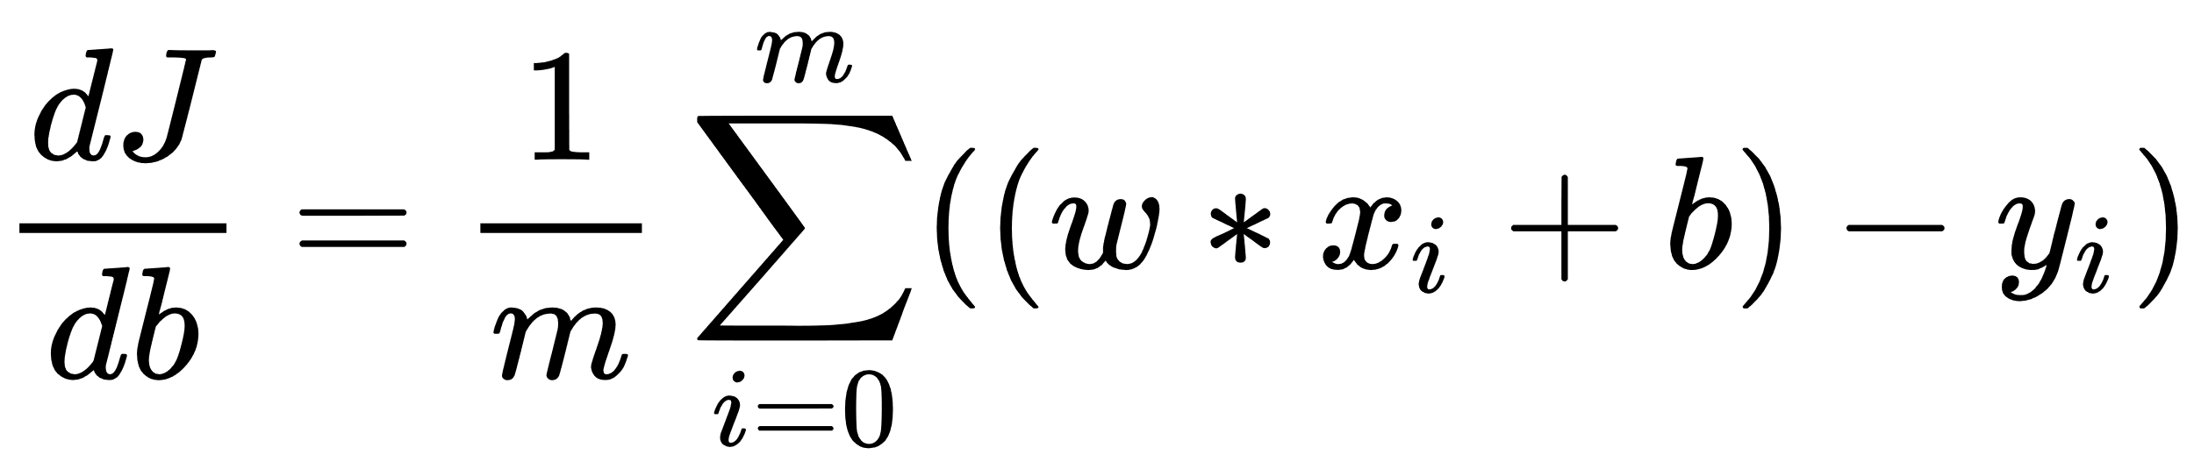
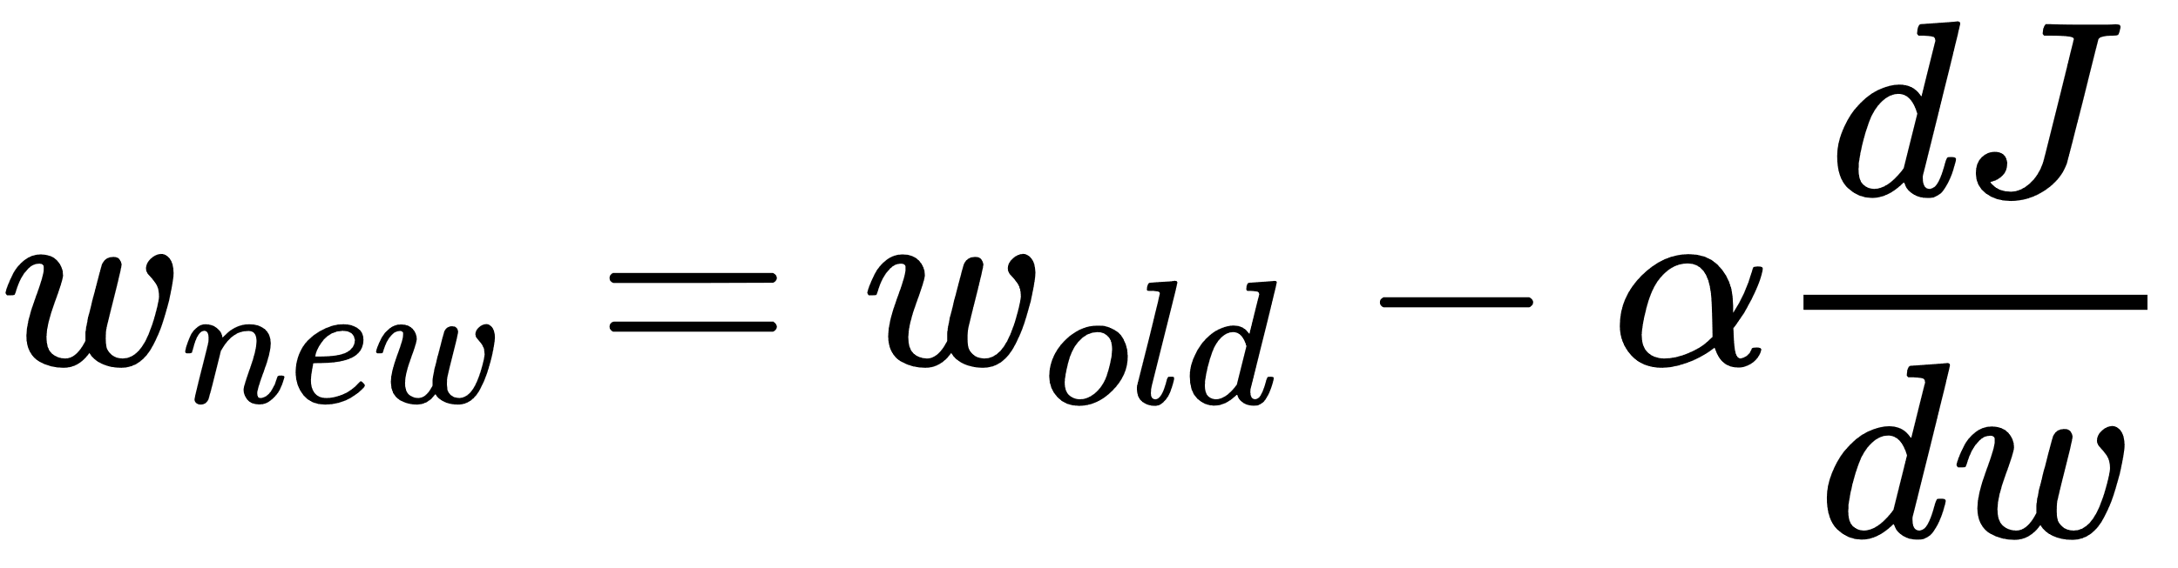
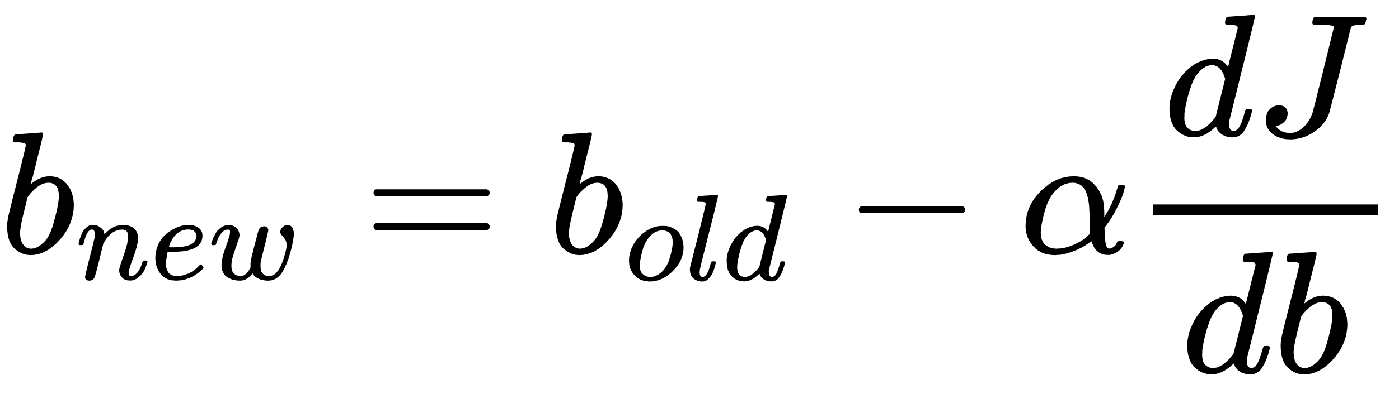
Gradient descent steps:
1- Start with random w and b
2- compute cost
3- compute derivative of cost with respect to w and b
3.1-
3.2-
4- use this derivative to update weight and bias
4.1-
4.2-
5- repeat 2,3,4 until converge or for some number of iterations

Slide 8
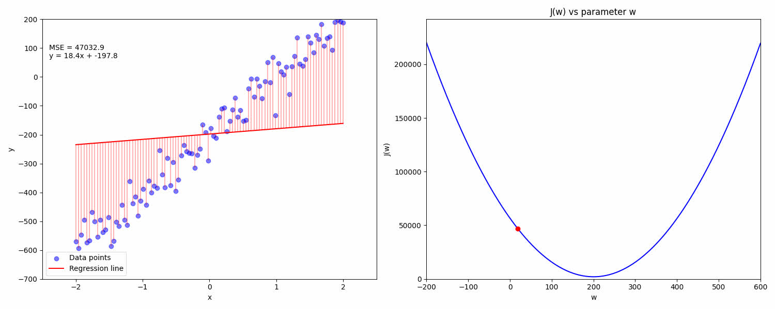
Gradient descent in action

Slide 9
After bulding our model we need to test it

Slide 10
There are a lot of metrics we can use to evaluate our model:
MAE (Mean Absolute Error)
MSE (Mean Square Error)
RMSE (Root Mean Square Error)
R2 (R-Squared value)

Slide 11
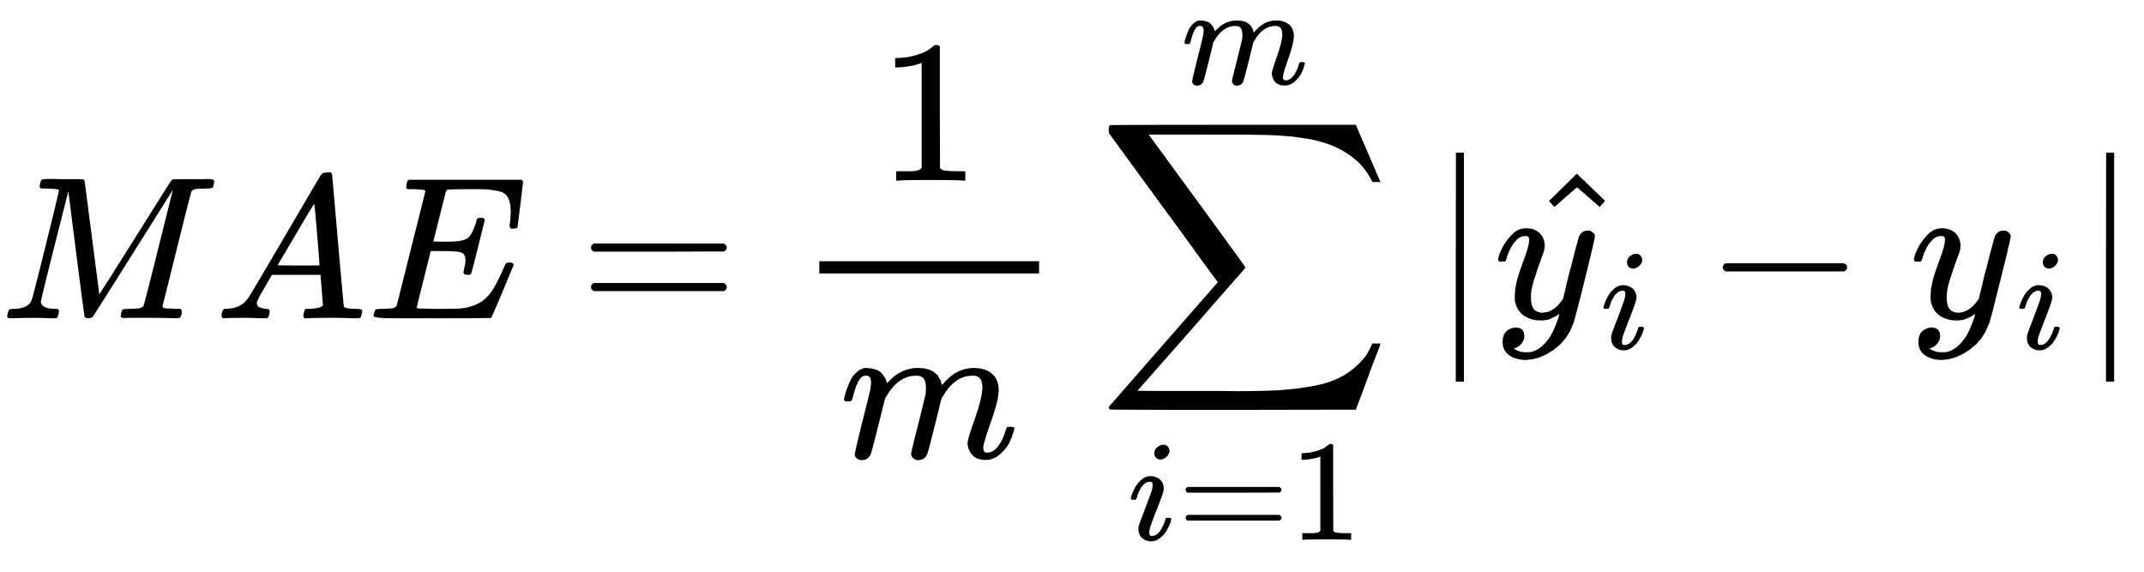
Advantages:
same unit as the output variable
Robust to outliers
Disadvantages:
Larger errors don’t get penalized as heavily

Slide 12
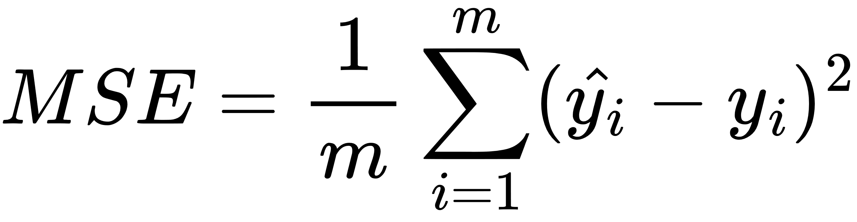
Advantages:
Large errors get penalized as we are squaring
Disadvantages:
Sensitive to outliers
value of MSE is a squared unit of output. Ex. the output variable is in meter(m) then after calculating MSE the output we get is in meter squared.

Slide 13
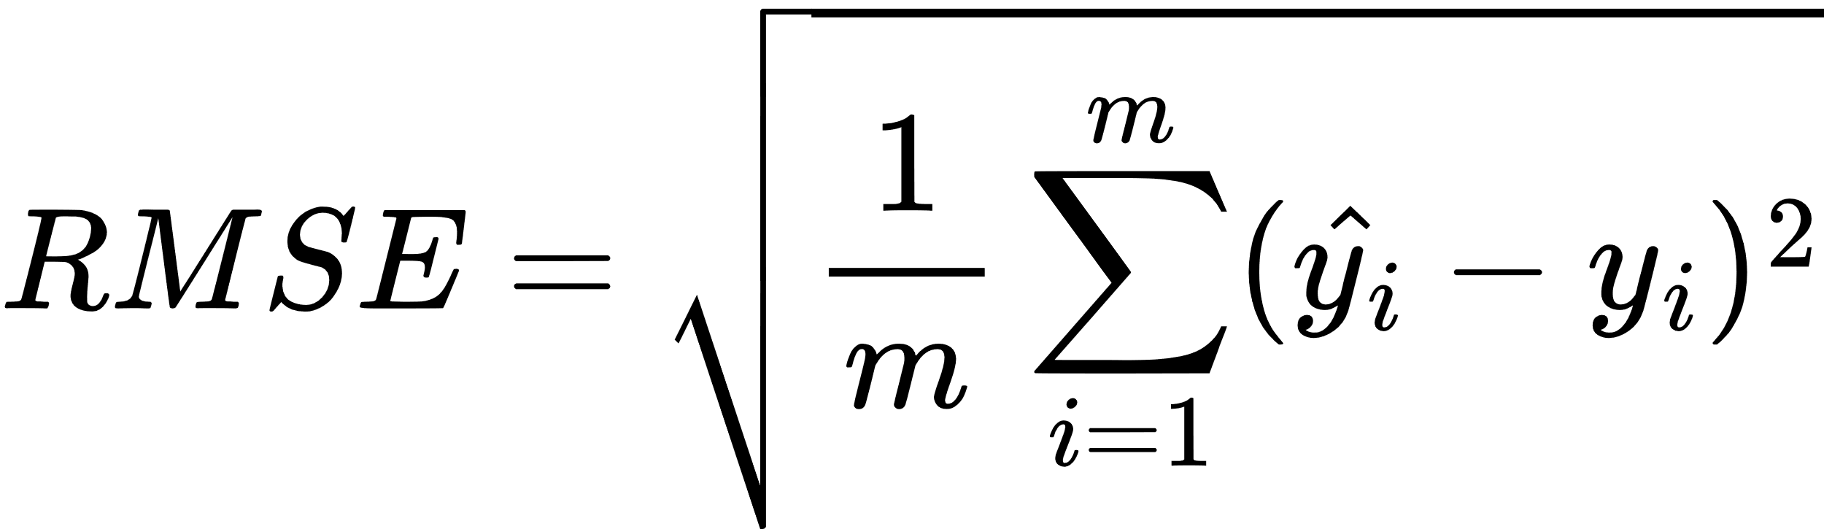
Advantages:
Large errors get penalized as we are squaring
same units as output variables
Disadvantages:
Sensitive to outliers

Slide 14
Previous measures focused on loss but what if I want to see performance

Slide 15
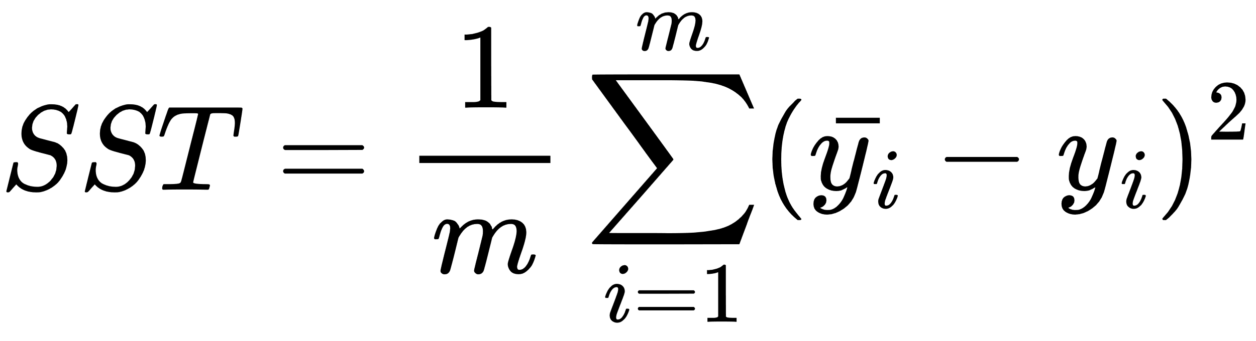
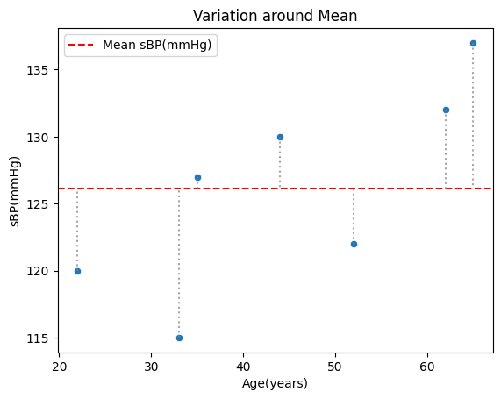
SST refers to sum of square total which gets error around mean line
In other words it is variance of data

Slide 16
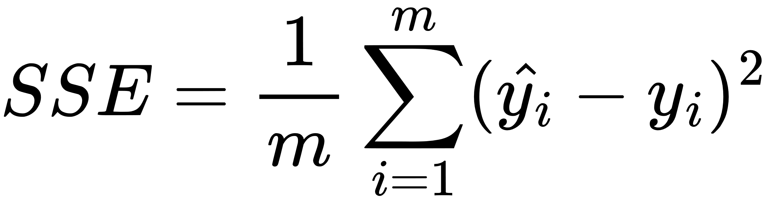
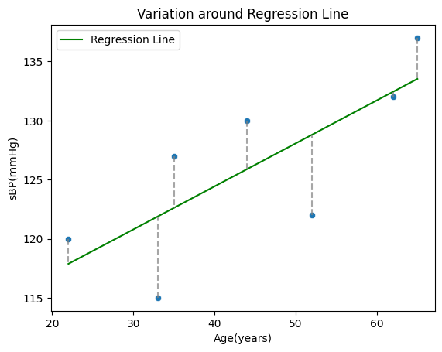
SSE refers to sum of square estimated which calculate error of our regression model

Slide 17
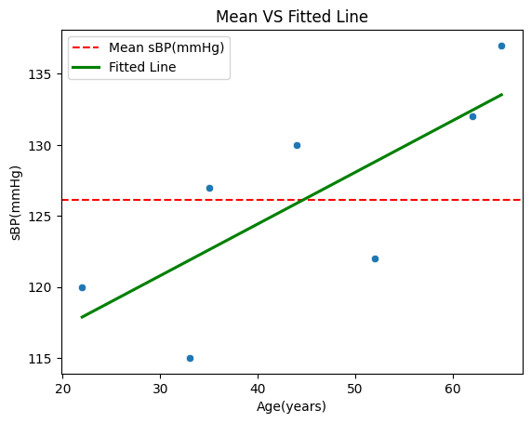
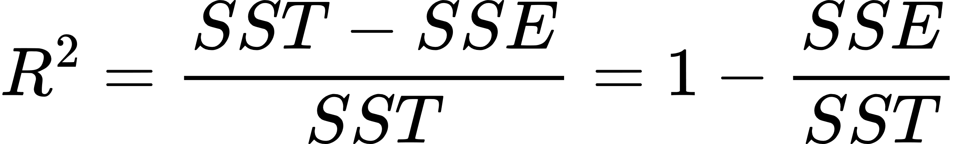
R2 refers to R-squared it measures how our model performs better than base line (mean)
Its values range from 0 to 1 as we approach 1 our model performs good

Slide 18
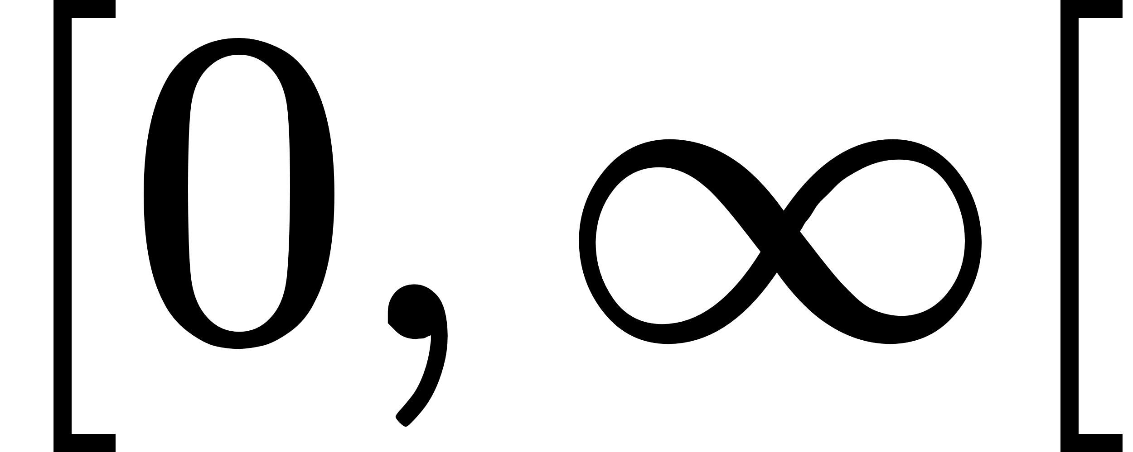
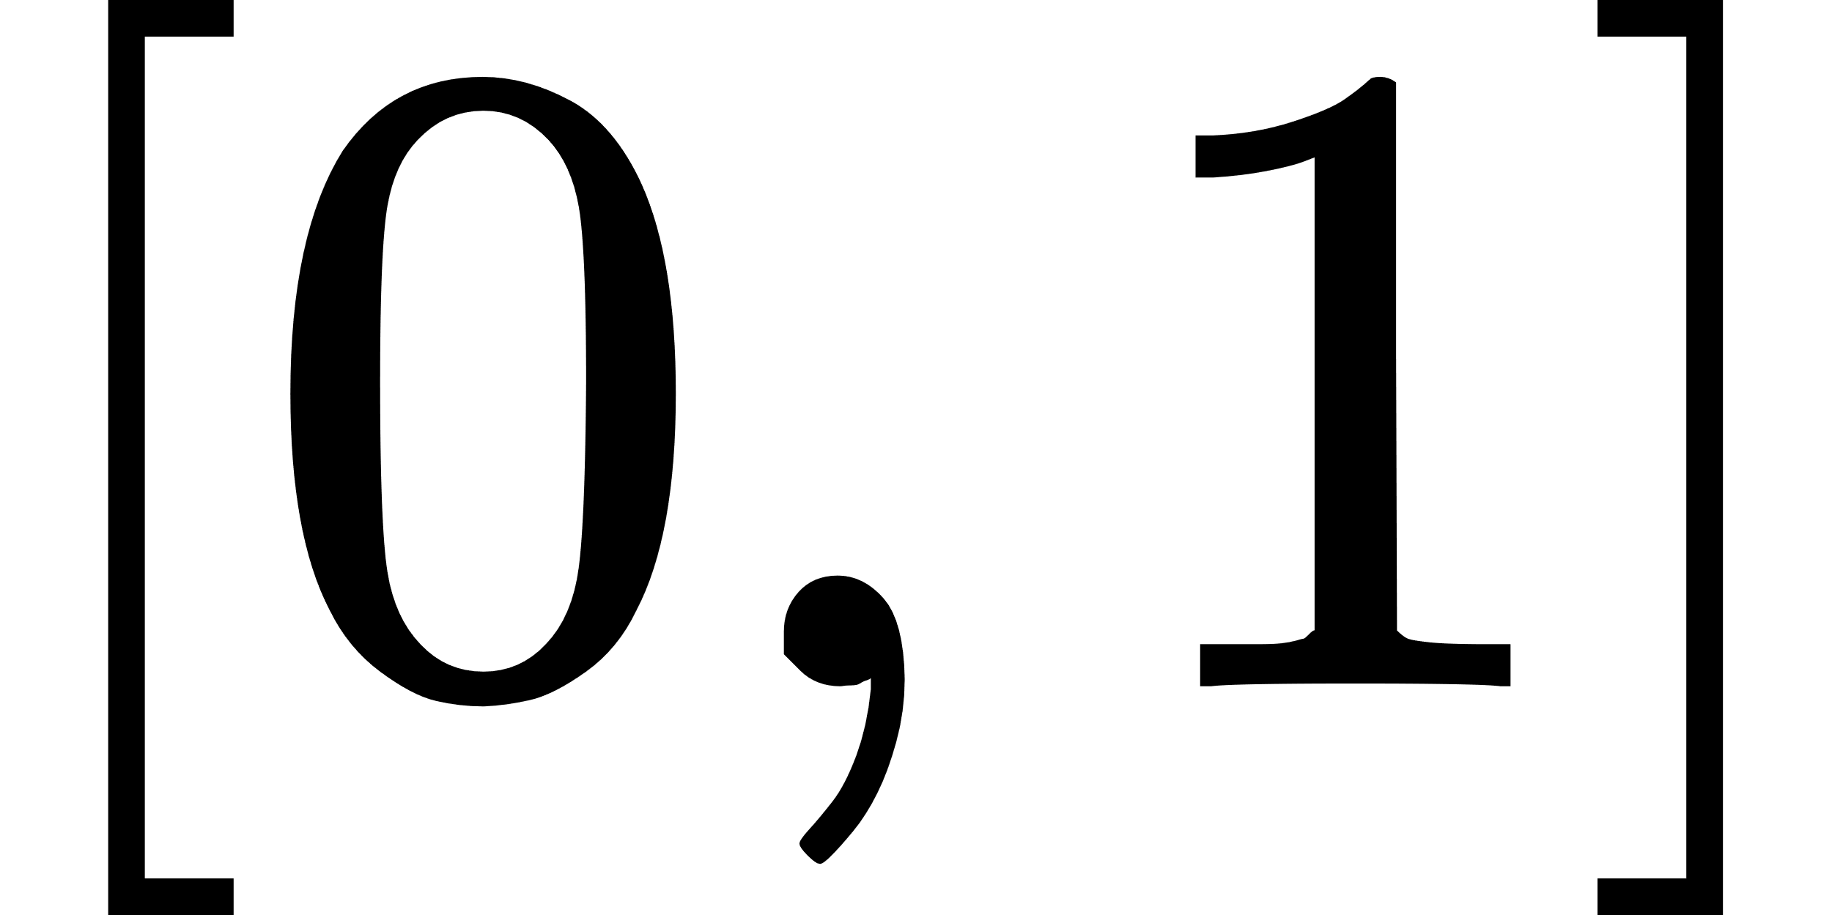
Summary
Metric | Range | When to use | Sensitive to Outliers
MAE |  | for models where robustness to outliers is important | NO
MSE |  | use for applications where large errors need to be penalized | YES
RMSE |  | use for applications where large errors need to be penalized | YES
R2 |  | Use R² to assess the overall goodness-of-fit of the model | NO

Slide 19
After Learning Evaluation lets see how we deal with our data to train and evaluate our model

Slide 20
Training our model on entire data
Data
Train

Slide 21
Is it a good choice to train model on entire data?

Slide 22
Training our model on training subset
and evaluate it on test subset
Data
Train
Test

Slide 23
This data subset is better than taking entire data for training,
but there is a hidden problem

Slide 24

What is that problem?
Repetition of evaluation on same test data subset leads to that model will try to adapt for this test subset and it will not generalize

Slide 25
So, what is the solution?

Slide 26
Solution:
Train on train subset
Evaluate on val. subset
Test on test subset
Data
Train
Val
Test

Slide 27
So, What is ratio of each subset
usually, 80% train, 10% validation and 10% test
But this ratio can change depends on problem and size of data

Slide 28
After knowing evaluation metrics and train, test split you will always meet on of following scenarios

Slide 29
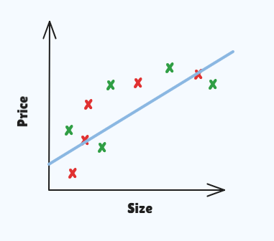
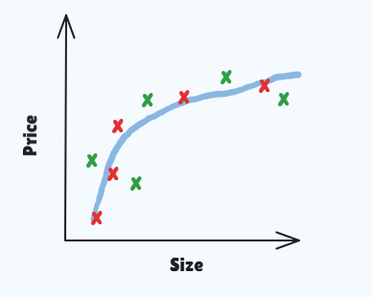
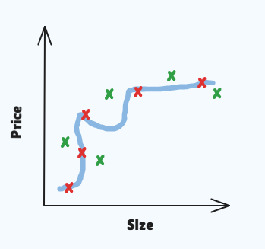
Train loss High
Val loss High
“Underfit”
Train loss Low
Val loss Low
“Normal”
Train loss Very low
Val loss High
“Overfit”

Slide 30
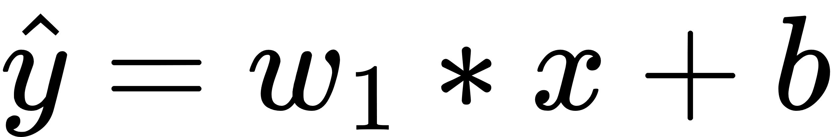
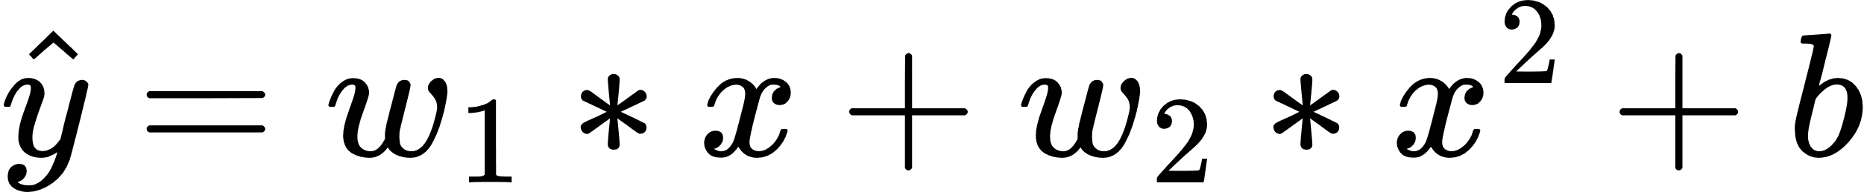
In normal case how model take this shape:
this equation can’t fit data as data is not linear we need to introduce non-linear to our equation
We can square size so that we change our equation from linear to polynomial

Slide 31
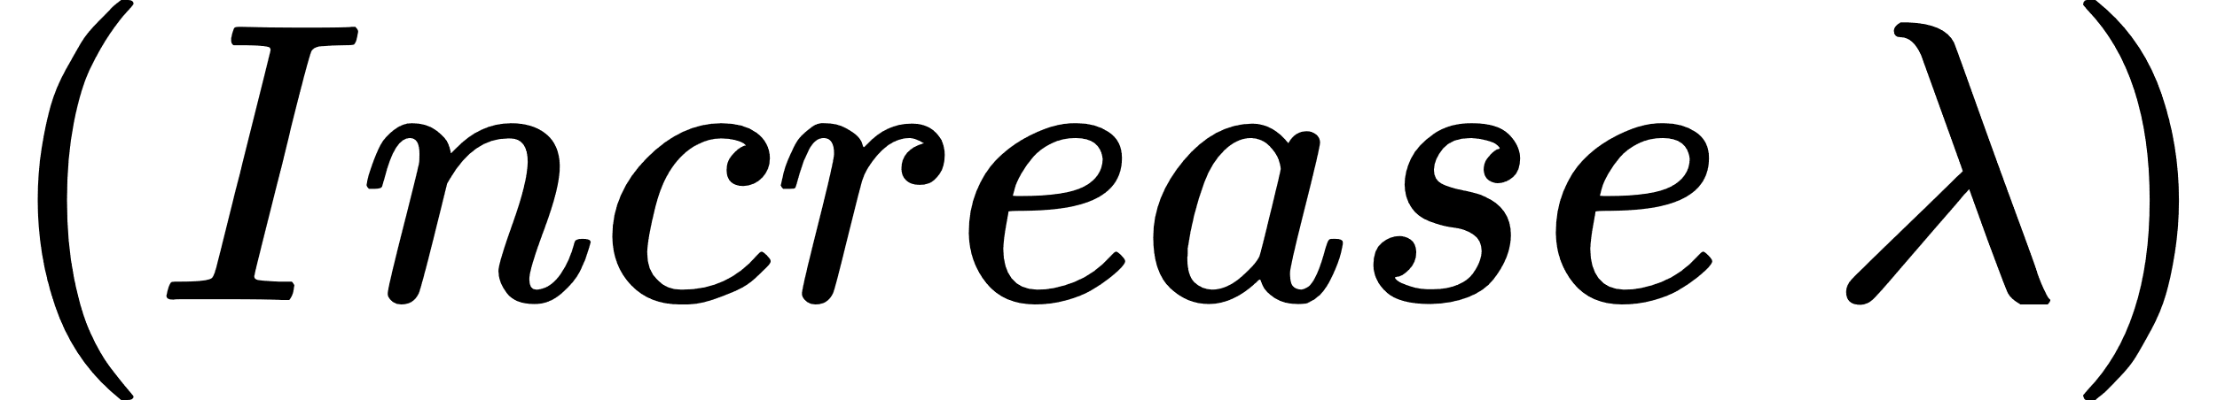
Possible solutions for Overfitting:
Get more training data
try smaller set of features
Use Regularization

Slide 32
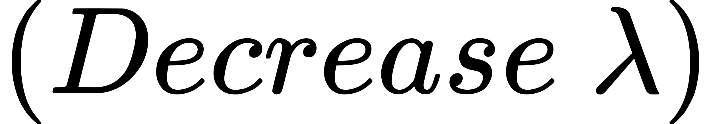
Possible solutions for underfitting:
try getting additional features
try adding polynomial features
Use Regularization

Slide 33
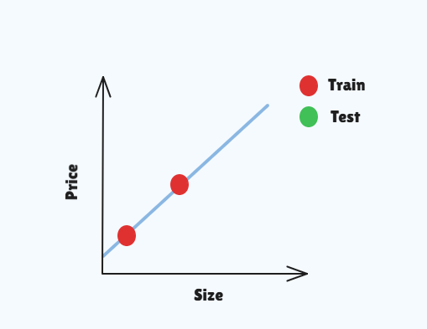
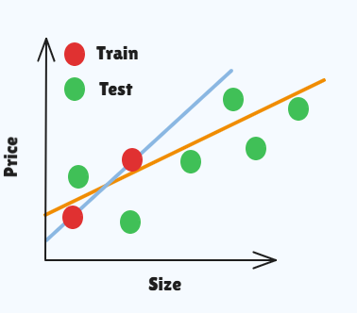
Overfitting in depth:
In figure (1):
train loss is approximately 0
but when we test our model
we can see in figure (2)
test loss is high and orange
line is what we expected from
training not blue line. we can
solve this by using Regularization
(1)
(2)

Slide 34
So, what is Regularization?

Slide 35
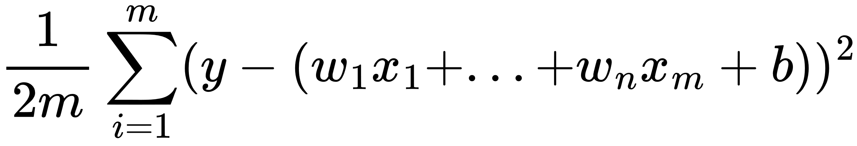
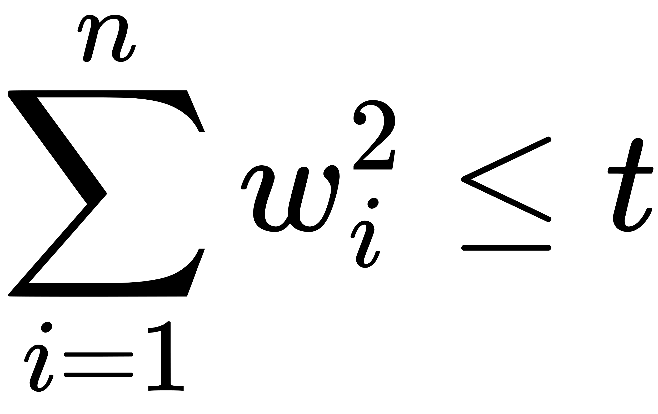
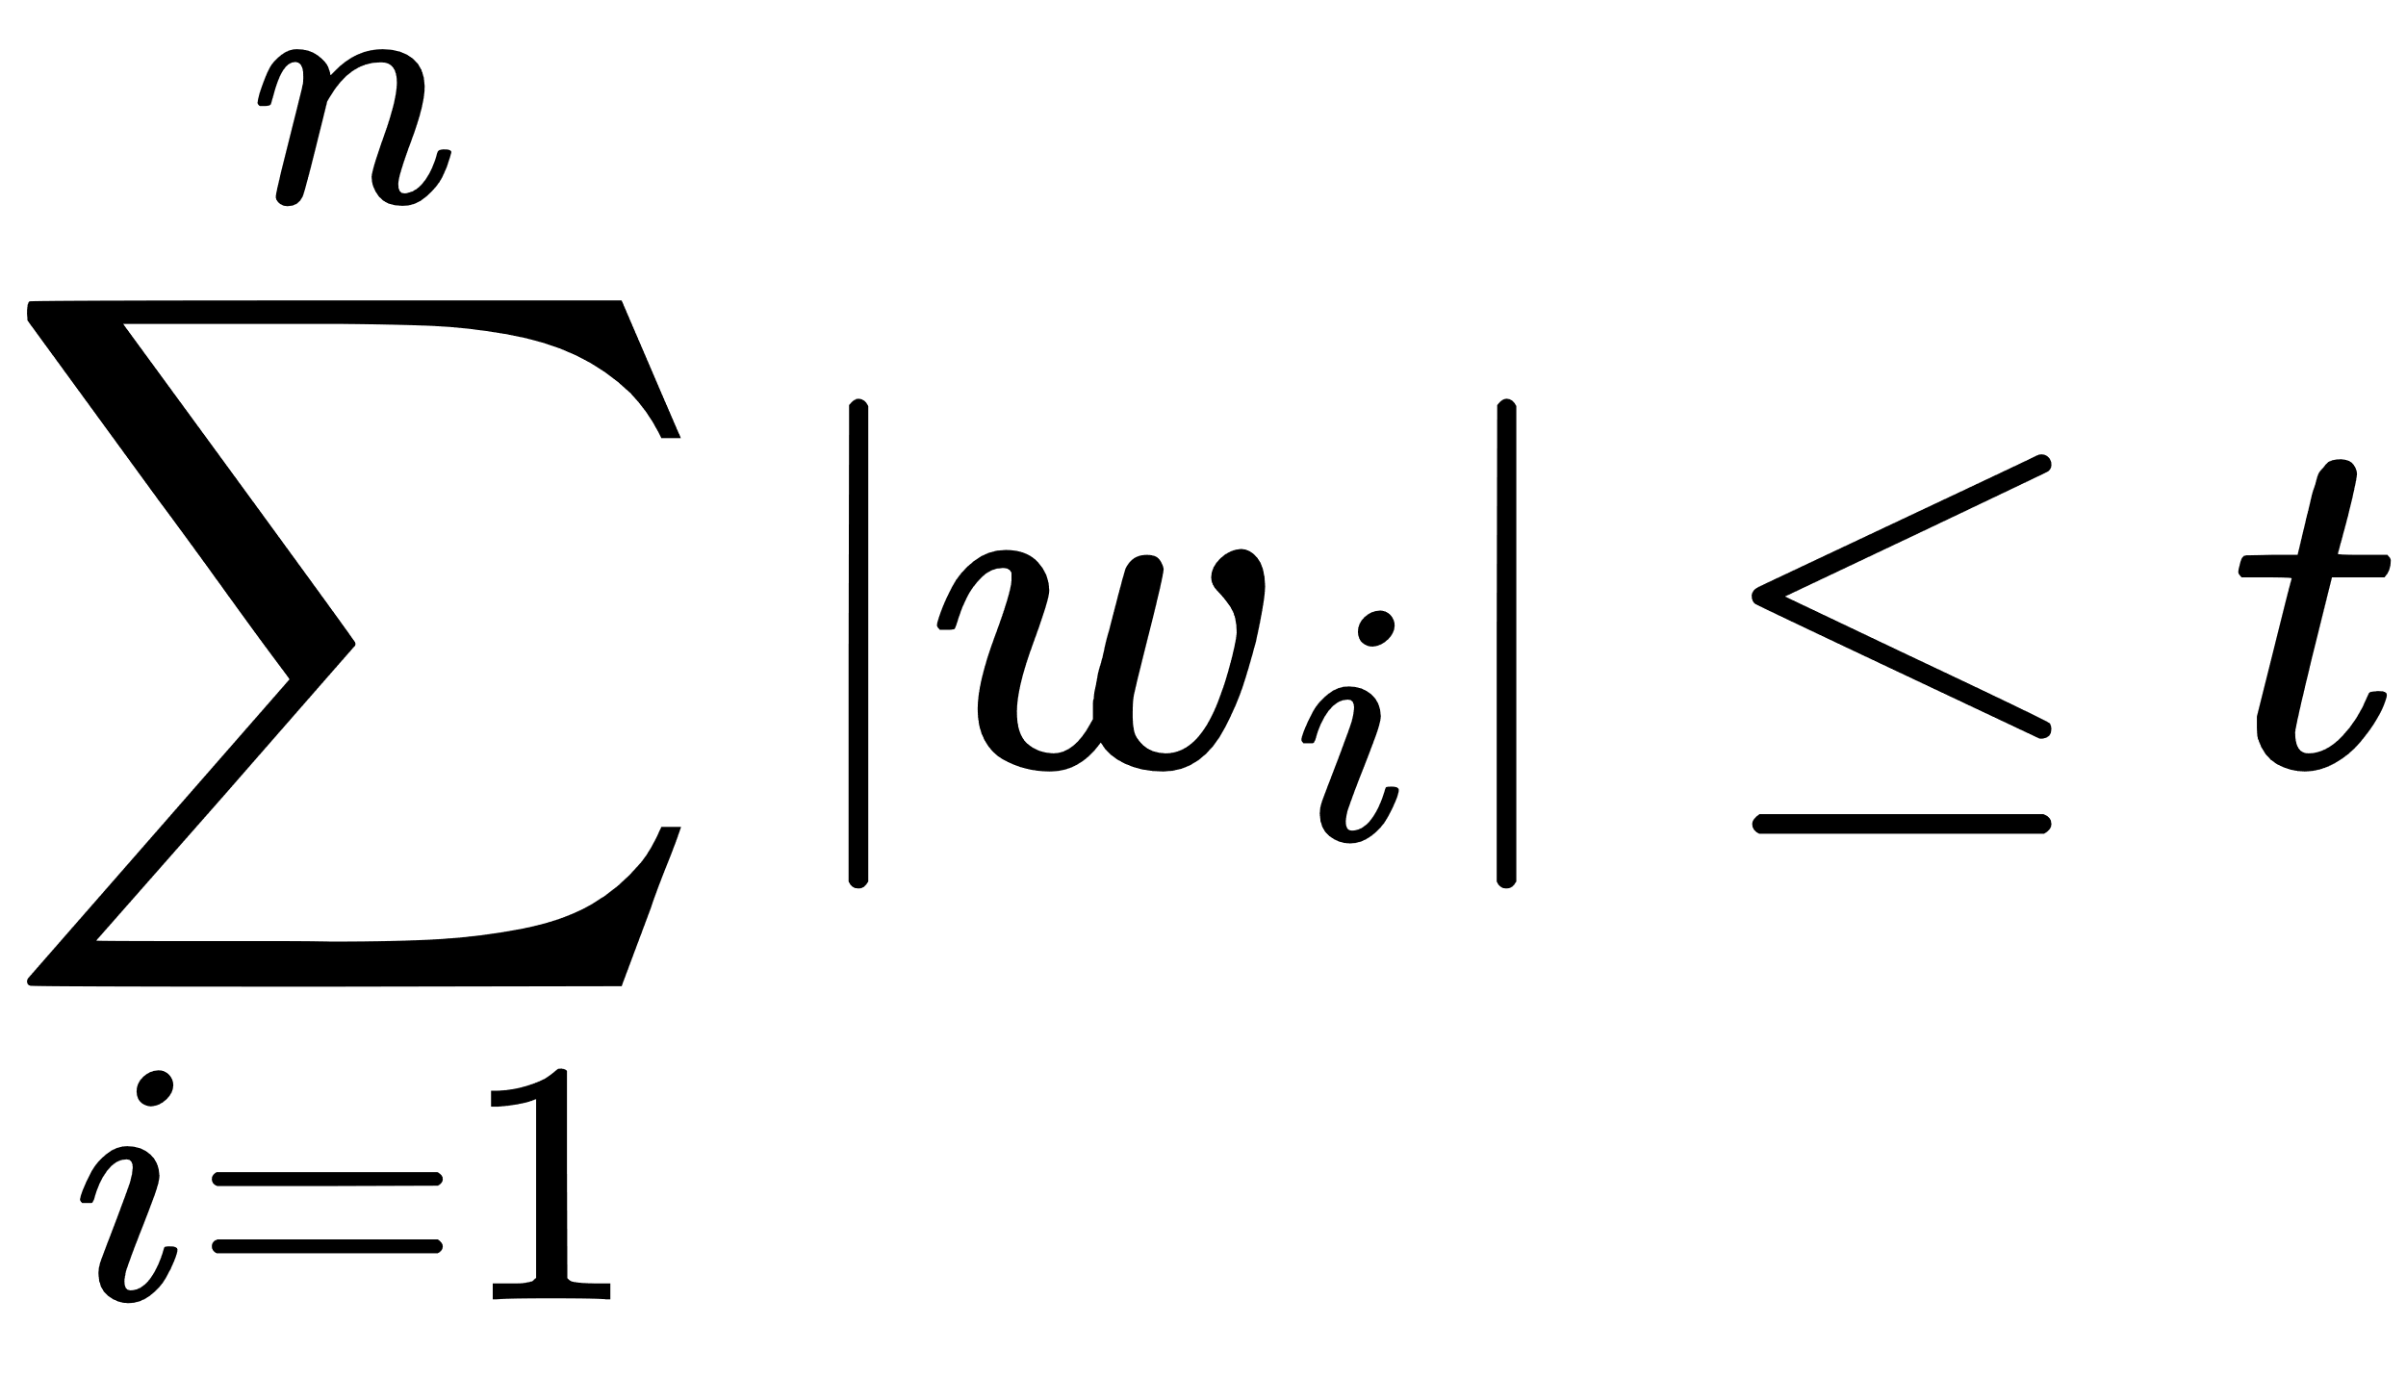
Regularization: is simply adding constrain to our optimization function
gradient descent in Linear Regression try to minimize:
gradient descent in Ridge Regression try to minimize:
with the constraint
gradient descent in Lasso Regression try to minimize:
with the constraint

Slide 36
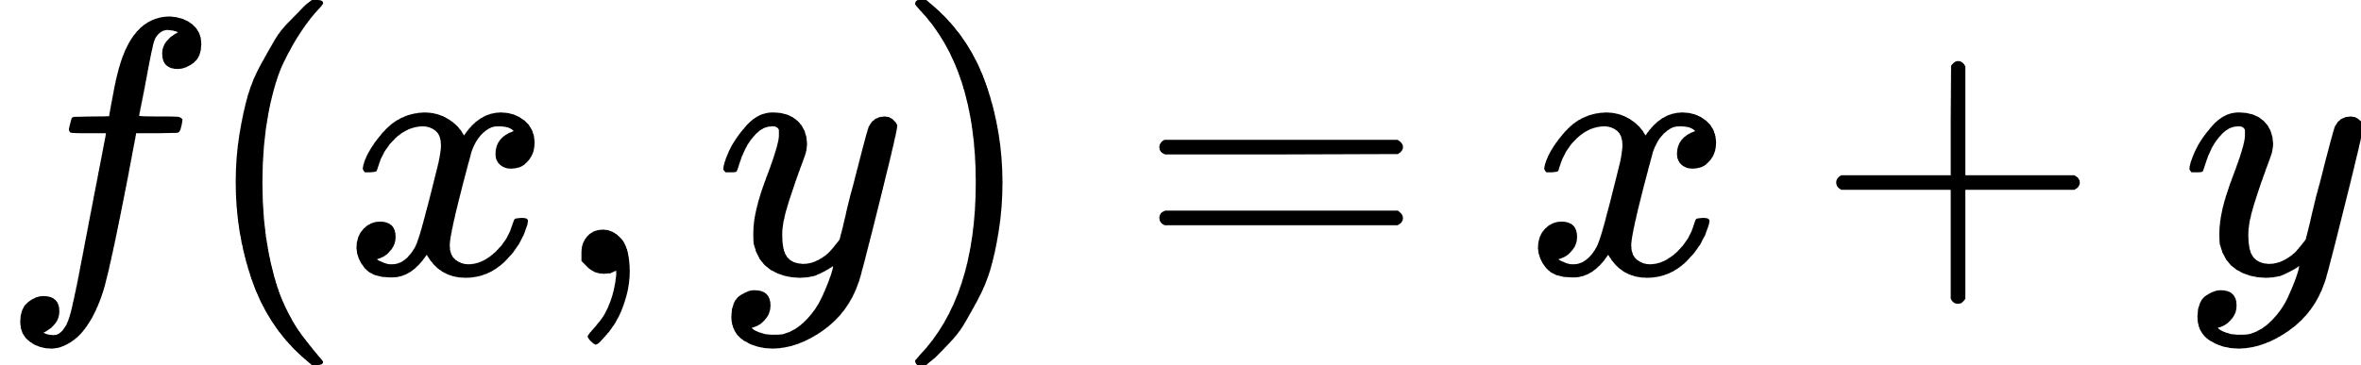
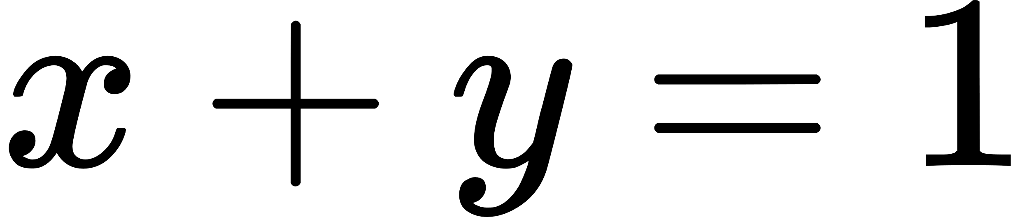

Simple Example:
We want to minimize:
under the constraints
Geometric solution
Algebraic Solution:
By lagrange multiplier methods, minimizing
under the constraints
is equivalent to

Slide 37
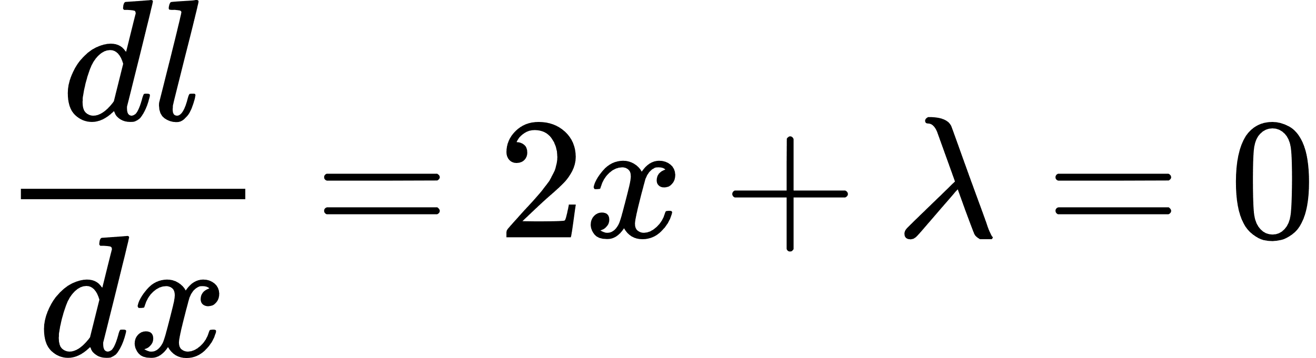
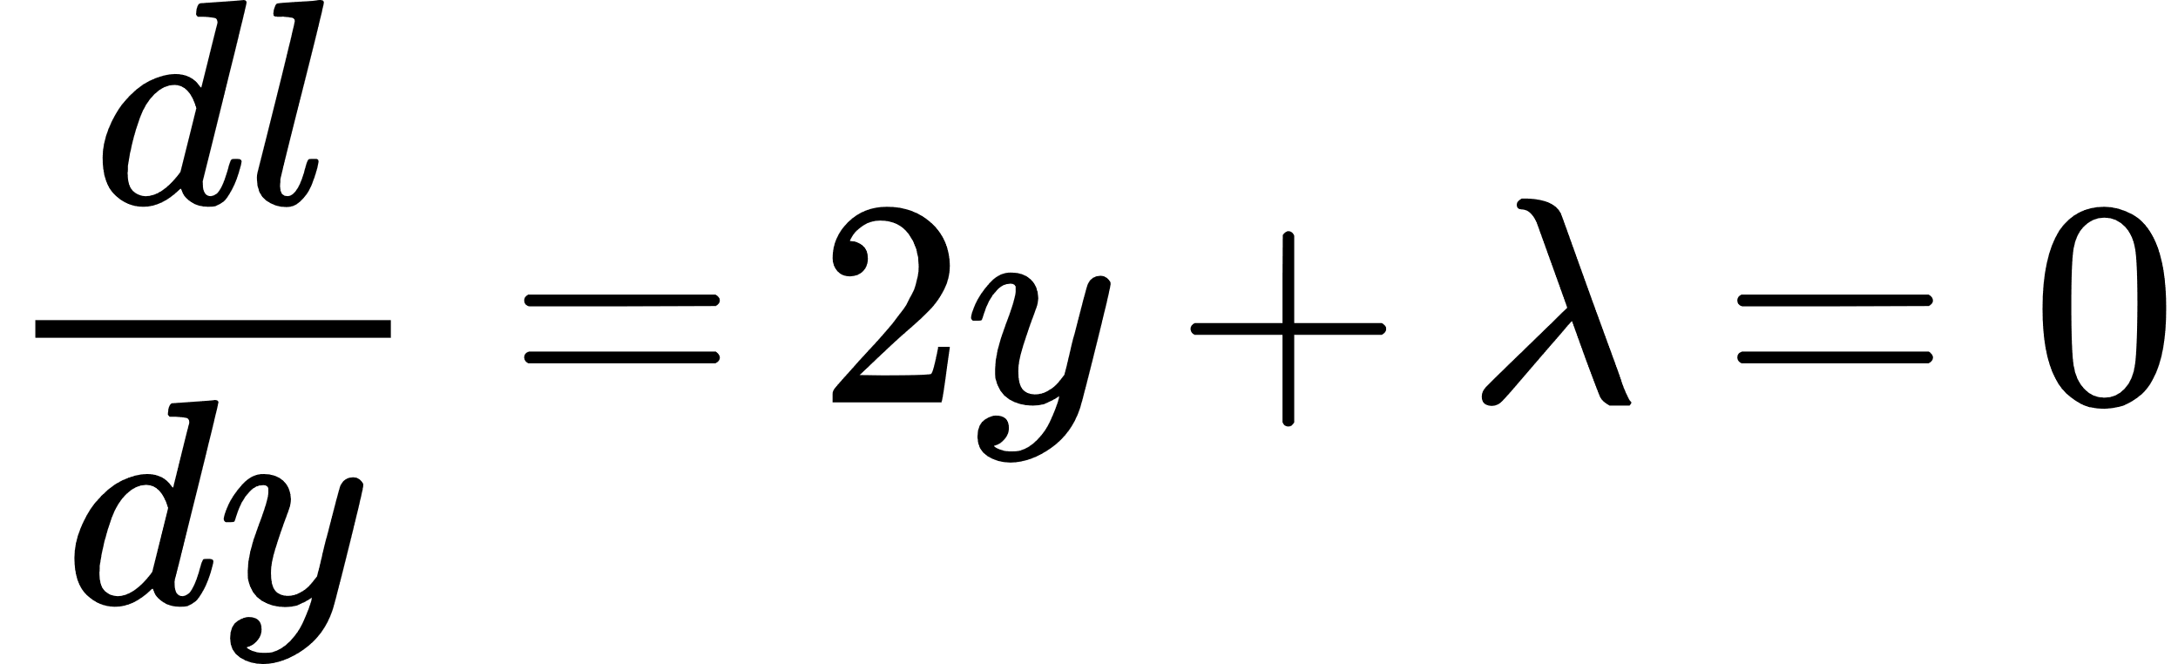
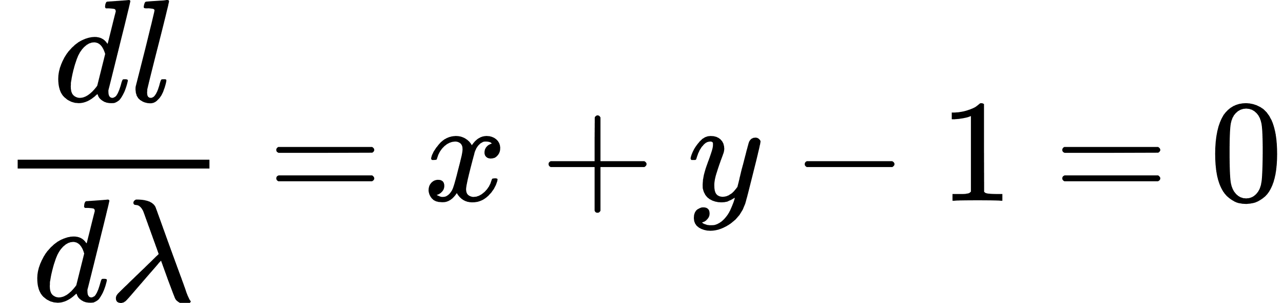
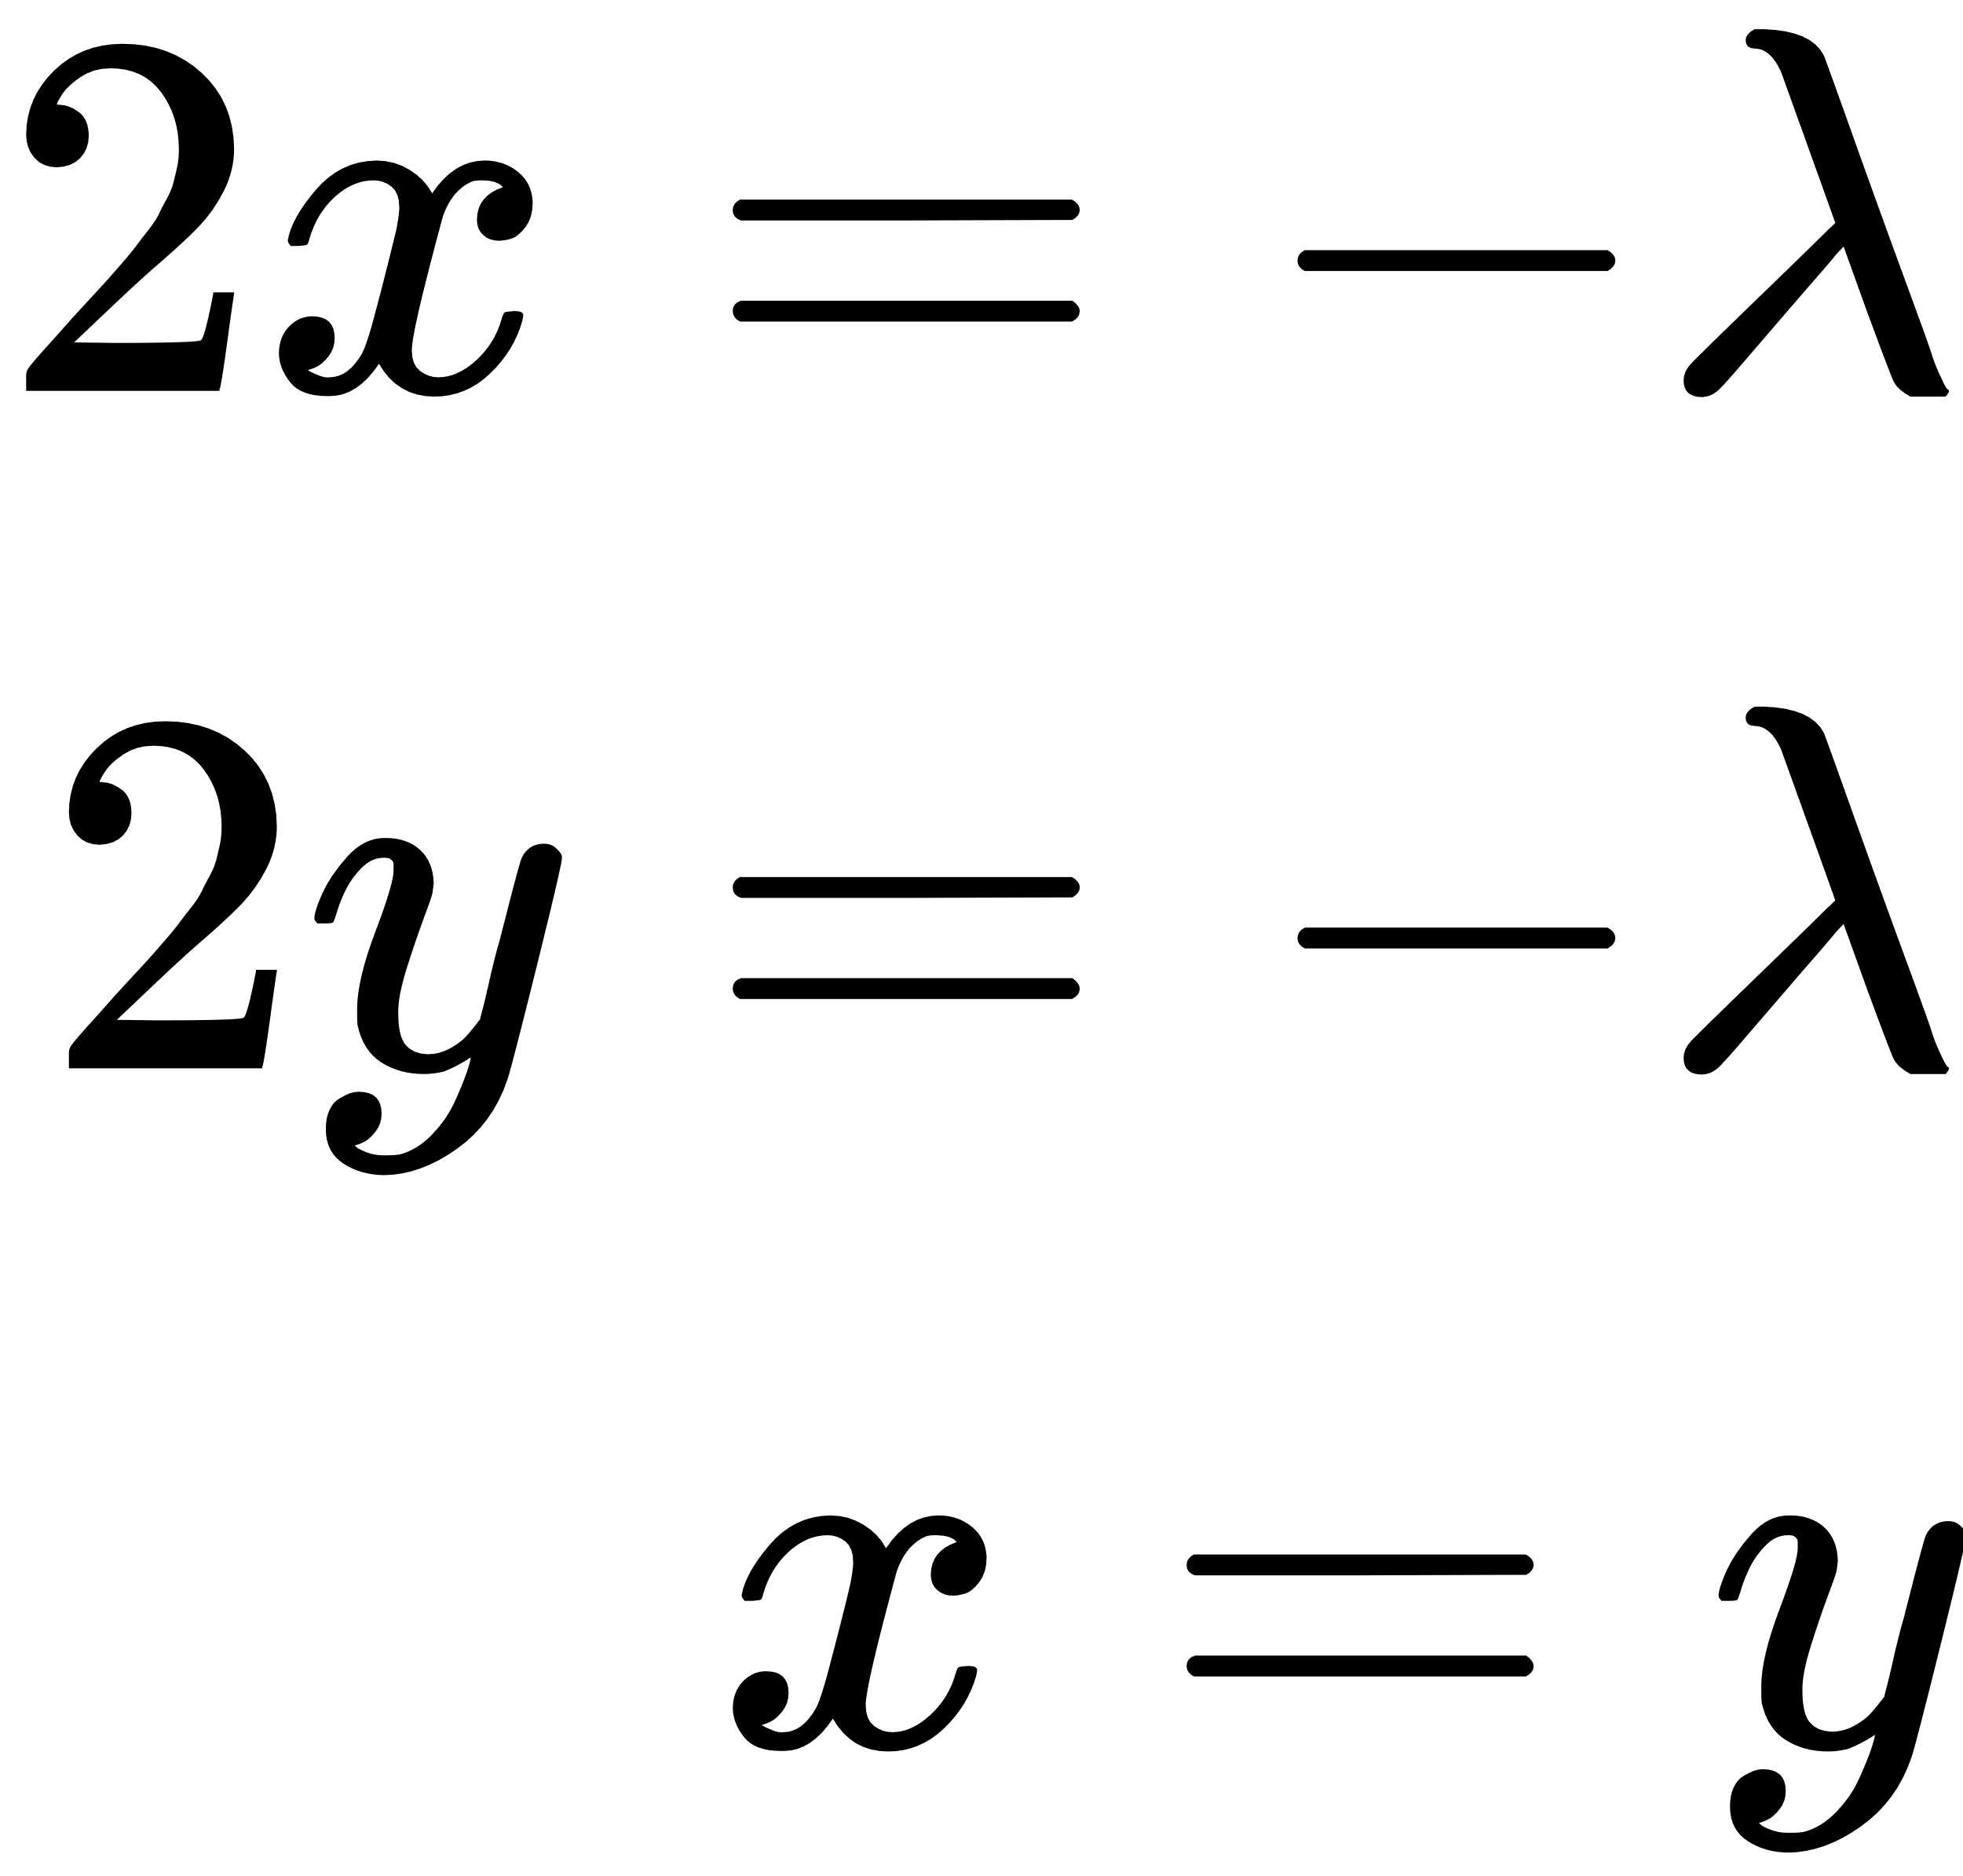


Simple Example:

Slide 38


By lagrange multiplier methods, minimizing
under the constraints
is equivalent to
Ridge Regression, minimizing
Lasso, minimizing

Slide 39




Ellipses are the contours of
(Left) Ellipse intersects the circle of radius t at the Ridge estimate
(Right) Ellipse intersects the square at the Lasso estimate

Slide 40
we can notice that Ridge can shrink weights to approximately zero
Lasso can shrink weights to zero so it can be used as feature selection

Slide 41
Last thing, how we can set λ?

Slide 42

λ values ranges from 0 to ꝏ
As λ ↓ 0 or t ↑ ꝏ, the Ridge and Lasso estimates become the ordinal MSE eq.
As λ ↑ ꝏ or t ↓ 0, the Ridge and Lasso estimates to zero (all weights become near zero in Ridge case and zero lasso case)

Slide 43
Thank you very much!

